Slide 1
ETHICAL THEORIES What Is a Moral Theory and how it functions?
A moral theory defines terms in uniform ways and links ideas and problems together in consistent ways [ Harris, Pritchard, and Rabins, 2000 ].
This is exactly how the scientific theories
used in other engineering classes function.

Slide 2
Types of Ethical Theories
There are four ethical theories that will be considered here, each differing according to what is held to be the most important moral concept.
Utilitarianism
Duty ethics
Rights ethics
Virtue ethics

Slide 3
Theorists
Ethical ideas were continually refined during the course of history. Many great thinkers have tried to provide insight into these issues through their writings. For example, philosophers such as Locke, Kant, and Mill wrote about moral and ethical issues.
The thinking of these philosophers is especially important for our study of engineering ethics, since they did not rely on religion to underpin their moral thinking. Rather, they acknowledged that moral principles are universal, regardless of their origin, and are applicable even in secular settings.

Slide 4
Uses and Criteria
The ethical theories are useful in many respects.
1. In understanding moral dilemma. They provide clarity, consistency, systematic and comprehensive understanding.
2. It provides helpful practical guidance in moral issues towards the solution.
3. Justifying professional obligations and decisions, and
4. In relating ordinary and professional morality

Slide 5
Utilitarianism
Utilitarianism holds that those actions are good that serve to maximize human well-being. utilitarianism is not on maximizing the well-being of the individual, but rather on maximizing the well-being of society as a whole.

Slide 6
Examples Building of Dams
Dams often lead to great benefit to society by providing
stable supplies of drinking water,
flood control, and
recreational opportunities.
But these benefits often come at the expense of people who live in areas that will be
flooded by the dam
and are required to find new homes,
or lose the use of their land

Slide 7
Problems/Criticisms
Utilitarianism tries to balance the needs of society with the needs of the individual, with an emphasis on what will provide the most benefit to the most people. But it has many problems also.
Sometimes what is best for everyone may be bad for a particular individual or a group of individuals.

Slide 8
Problems
Another objection to utilitarianism is that its implementation depends greatly on knowing what will lead to the most good.
It is often impossible to do a complete set of experiments to determine all of the potential outcomes, especially when humans are involved as subjects of the experiments. So, maximizing the benefit to society involves guesswork and the risk that the best guess might be wrong.
Despite these objections, utilitarianism is a valuable tool for ethical problem solving, providing one way of looking at engineering ethics cases.

Slide 9
Duty Ethics and Rights Ethics
duty ethics and rights ethics—are similar to each other and will be considered together.
These theories hold that those actions are good that respect the rights of the individual. Here, good consequences for society as a whole are not the only moral consideration.
Immanuel Kant (1724–1804), proponent--- ethical actions are those actions that could be written down on a list of duties: be honest, don’t cause suffering to other people, be fair to others, etc. Ethical acts are a result of proper performance of one’s duties.

Slide 10
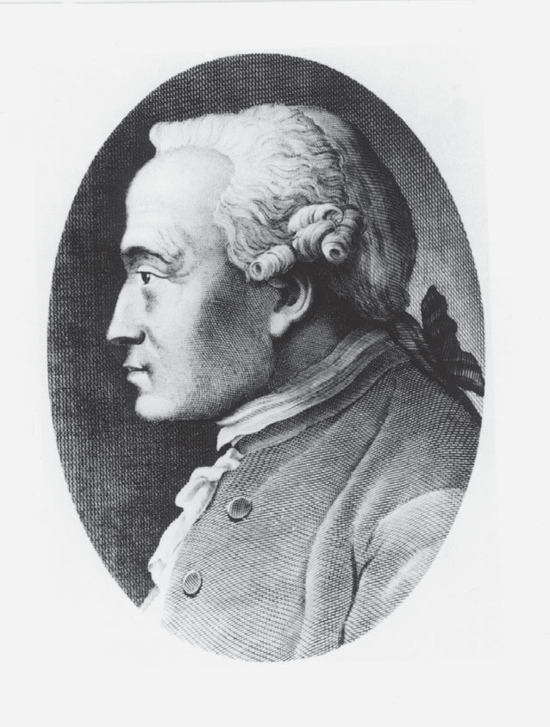

Slide 11
Right ethics by John Locke
Right ethics was largely formulated by John Locke (1632–1704), whose statement that humans have the right to life, liberty, and property was paraphrased in the Declaration of Independence of the soon-to-be United States of America in 1776. Rights ethics holds that people have fundamental rights that other people have a duty to respect.

Slide 12
Both theories are the two different sides of the same coin and achieve the same end
In duty ethics, people have duties, an important one of which is to protect the rights of others.
And in rights ethics, people have fundamental rights that others have duties to protect.
As per Kant we have duties to ourselves, as we are rational and autonomous beings. We have a duty not to commit suicide; a duty to develop our talents and a duty to avoid harmful drugs. Kant insisted that moral duties are categorical imperatives. They are commands that we impose on ourselves as well as other rational beings. For example, we should be honest because honesty is required by duty. A businessman is to be honest because honesty pays — in terms of profits from customers and from avoiding jail for dishonesty.

Slide 13
Examples with problems
Like utilitarianism, there are problems with the duty and right ethics theories that must be considered.
First the basic rights of one person (or group) may conflict with the basic rights of another group.
How do we decide whose rights have priority?
In the example of the building of dam if the dam is located in the land of people or harms the land of the people then the property right is enough to stop the dam project. However, there is a need for others living in nearby
communities to have a reliable water supply and to be safe from continual flooding.
Whose rights are paramount here? Rights and duty ethics don’t resolve this conflict
very well; hence, the utilitarian approach of trying to determine the most good is more useful in this case

Slide 14
Continue ……
However, there is a need for others living in nearby communities to have a reliable water supply and to be safe from continual flooding.
Whose rights are paramount here? Rights and duty ethics don’t resolve this conflict very well; hence, the utilitarian approach of trying to determine the most good is more useful in this case.
Second problem with duty and rights ethics is that these theories don’t always account for the overall good of society very well.
Since the emphasis is on the individual, the good of a single individual can be paramount compared to what is good for society as a whole.
Thus, any complete analysis of an ethical problem must incorporate multiple theories if valid conclusions are to be drawn.

Slide 15
Virtue Ethics (tied to personal character)
Fundamentally, virtue ethics is interested in determining what kind of people we should be. In virtue ethics, actions are considered right if they support good character traits (virtues) and wrong if they support bad character traits (vices) [ Schinzinger and Martin, 2000.
Virtue ethics focuses on words such as responsibility, honesty, competence, and loyalty, which are virtues. Other virtues might include trustworthiness, fairness, caring, citizenship, and respect. Vices could include dishonesty, disloyalty, irresponsibility, or incompetence.
However, personal morality cannot, or at any rate should not, be separated from professional morality. If a behavior is virtuous in the individual’s personal life, the behavior is virtuous in his or her professional life as well.

Slide 16
Continue…. Application
However, we can use virtue ethics in our engineering career by answering questions such as:
Is this action honest?
Will this action demonstrate loyalty to my community and/or my employer?
Have I acted in a responsible fashion?
Often, the answer to these questions makes the proper course of action obvious.
To use virtue ethics analysis of an ethical problem, you should first identify the virtues or vices that are applicable to the situation.
Then, determine what course of action each of these suggests.

Slide 17
Criticisms
Problems can arise with words that on the face seem to be virtues, but can actually lead to vices.
For example, the concept of “honor” has been around for centuries and is often viewed positively. One sense of the word “honor” is a code of dignity, integrity, and pride. Honor may seem like a very positive thing, especially the aspects related to integrity. But the aspects related to pride can often have negative consequences.
There are numerous examples in history of wars that have been fought and atrocities committed in order to preserve the honor of an individual or nation.
Individuals have often committed crimes as a way of preserving their honor.

Slide 18
In the virtue ethics, it is important to ensure that the traits you identify as virtues are indeed virtuous and will not lead to negative consequences.

Slide 19
Which Theory to Use?
How do we decide which theory is applicable to a given problem? The good news is that in solving ethical problems, we don’t have to choose from among these theories.
Rather we can use all these to analyze a problem from different angles and see what result each of the theories gives us. This allows us to examine a problem from different perspectives to see what conclusion each one reaches. Frequently, the result will be the same even though the theories are very different.

Slide 20
Examples
for example, a chemical plant near a small city that discharges a hazardous waste into the groundwater. If the city takes its water from wells, the water supply for the city will be compromised and significant health problems for the community may result.
#Rights ethics indicates that this pollution is unethical, since it causes harm to many of the residents.
#A utilitarian analysis would probably also come to the same conclusion, since the economic benefits of the plant would almost certainly be outweighed by the negative effects of the pollution and the costs required to ensurea safe municipal water supply.

Slide 21
Continue….
Virtue ethics would say that discharging wastes into groundwater is irresponsible and harmful to individuals and so shouldn’t be done.
In this case, all of the ethical theories lead to the same conclusion.

